Slide 1
CO2 vs Death Rate
Ryan M Lence

Slide 2
Dataset(s)
Which dataset did you use of the following:
World Development Indicators Dataset
With a focus on
CO2 emissions (metric tons per capita)
Death rate, crude (per 1,000 people)

Slide 3
Motivation
CO2 gets a bad rap in the media at large, however it seems to be an important indicator of how much technological progress a country has made. I wanted to see if there is a correlation between CO2 per person and the crude death rate indicator.

Slide 4
Research Question(s)
What have been the death rate and CO2 trends. If we compare these two indicators can we spot a trend?
Can we correlate countries with rising CO2 levels and a lower death rate?

Slide 5
Findings
Overall as the CO2 per person has risen the death rate worldwide has fallen. This is true with most countries. Some Countries like the United States however have had a high CO2 level per person from 1960 on. It seems like the trend is that as a country adapts technology, its death rate will fall, but the CO2 level will rise to a point and then level out, and start to fall per person. The death rate has a similar leveling out affect as well. Their does seem to be a direct correlation between death rate and CO2 levels, and it’s a sign that a country has started to develop.

Slide 6
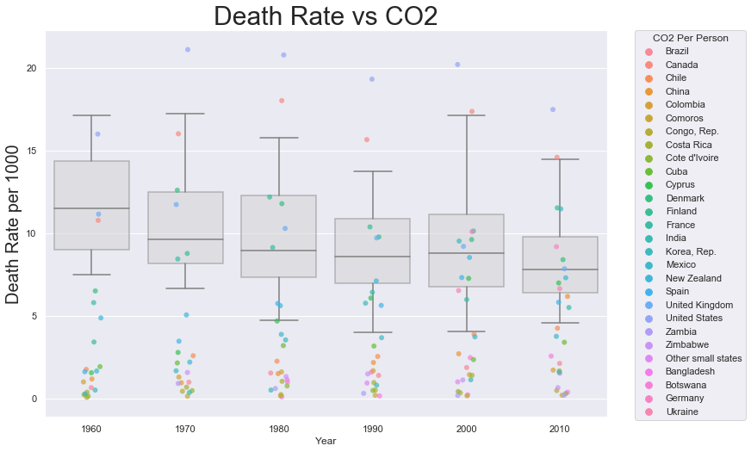

Slide 7
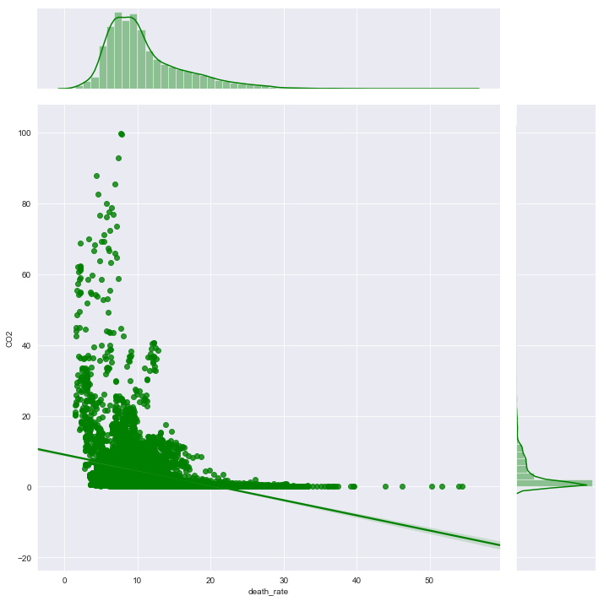

Slide 8
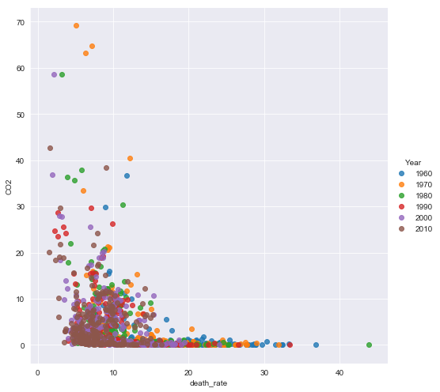

Slide 9
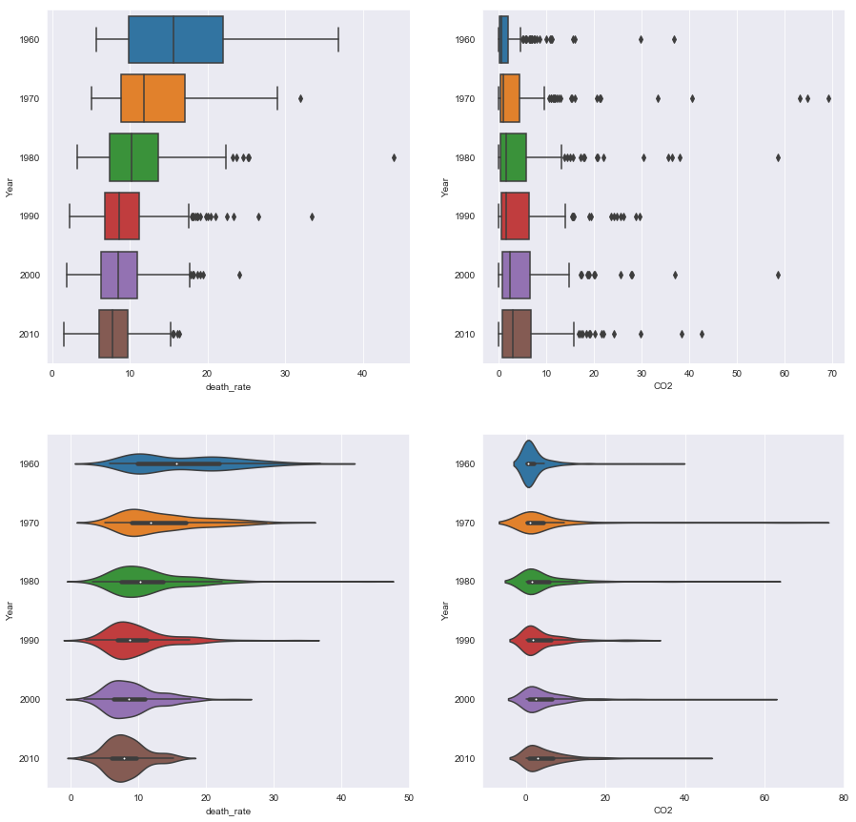

Slide 10
Acknowledgements
No one has given me any feedback

Slide 11
References
I also went through a Python class from Super Data Science to get more ideas on the visualizations.

